Slide 1
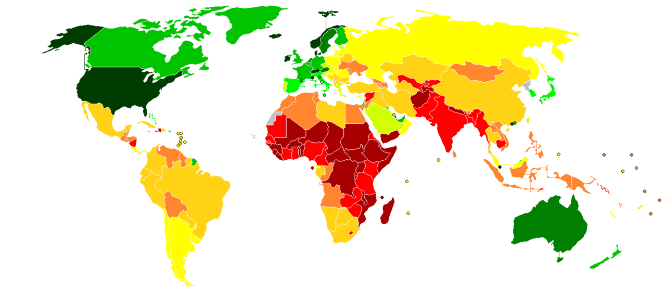
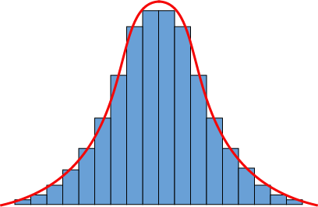
Relação do PIB per capita com a produção científica de cada país

Slide 2
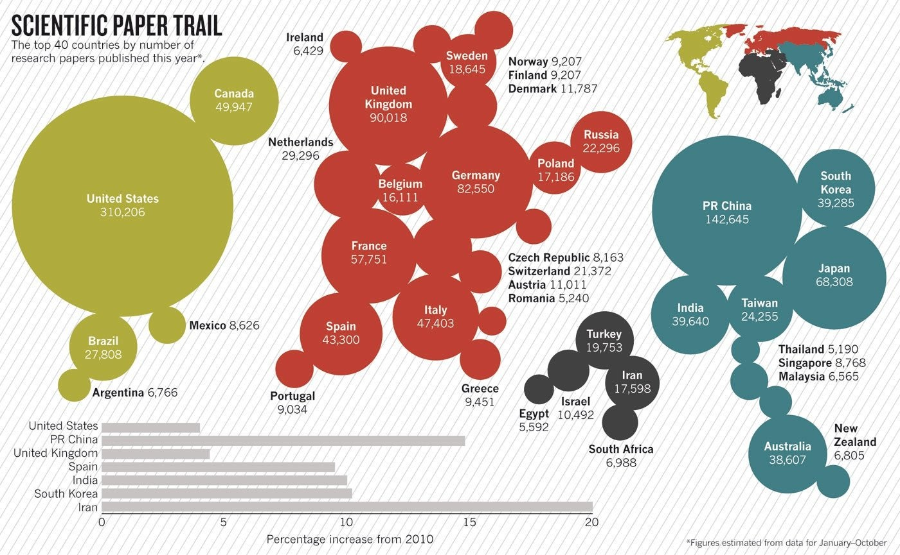
NATURE | NEWS
365 days: 2011 in review
From neutrinos to stem cells: a round-up of the year in research and science policy.
Richard Van Noorden
Source: Thomson Reuters/Web of Science, 2011

Slide 3
Presented this way, there's some "bias" towards countries with a larger population. I was thus wondering if statistics on the number of scientific publications per capita was available for countries?
... just out of curiosity.
Source: StackExchange

Slide 4
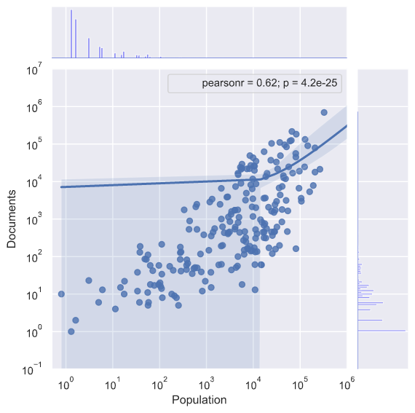
Documents
vs.
Population
R² = 0,38

Slide 5
Ranking - documents per capita
Country | Population | GDP(Million USD) | Papers | Papers Per Capita*1000 | GDP/Paper
Switzerland | 7,997,000 | 631,183 | 21,372 | 2.673 | 29.533
Denmark | 5,590,000 | 314,889 | 11,787 | 2.109 | 26.715
Sweden | 9,517,000 | 523,804 | 18,645 | 1.959 | 28.094
Norway | 5,019,000 | 499,667 | 9,207 | 1.834 | 54.270
Netherlands | 16,770,000 | 770,067 | 29,296 | 1.747 | 26.286
Australia | 22,680,000 | 1,564,419 | 38,607 | 1.702 | 40.522
Finland | 5,414,000 | 247,389 | 9,207 | 1.701 | 26.870
Singapore | 5,312,000 | 276,520 | 8,768 | 1.651 | 31.537
New Zealand | 4,433,000 | 171,256 | 6,805 | 1.535 | 25.166
Belgium | 11,140,000 | 483,402 | 16,111 | 1.446 | 30.004
Canada | 34,880,000 | 1,821,445 | 49,947 | 1.432 | 36.468
United Kingdom | 63,230,000 | 2,417,600 | 90,018 | 1.424 | 26.857
Ireland | 4,589,000 | 210,638 | 6,429 | 1.401 | 32.764
Israel | 7,908,000 | 241,069 | 10,492 | 1.327 | 22.976

Slide 6
What else may influence scientific production?
% GDP per capita invested in R&D and Education
But is it really a good metric?

Slide 7
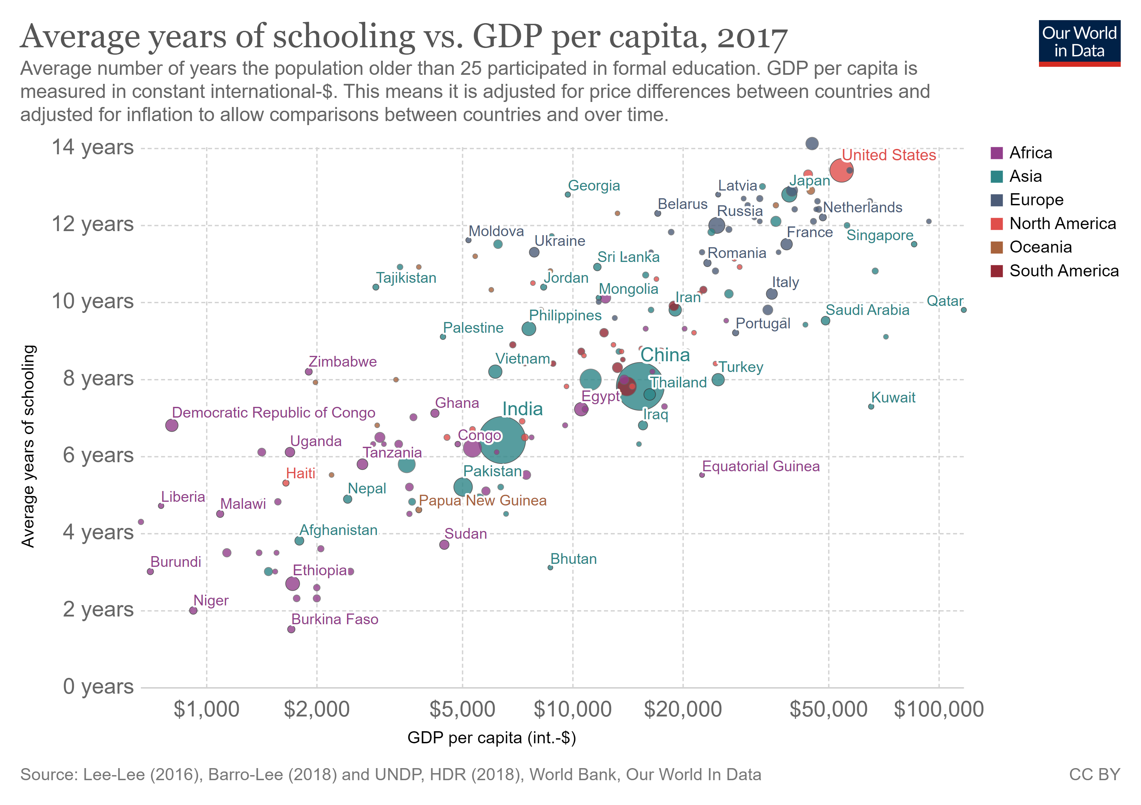
R² = 0,37

Slide 8
Population and investments play an obvious role.
But what about red tape?

Slide 9
Combines into a single grouping responses on the quality of public service provision, the quality of the bureaucracy, the competence of civil servants, the independence of the civil service from political pressures, and the credibility of the government's commitment to policies.
Government
Effectiveness
Index

Slide 10





Is it possible to predict a country’s GDP per capita using variables related to its population, scientific production and government efficiency?
GDP per capita
Intellectual property (WIPO)
Demographic data
Avg. adult schooling
Baseline Data
Scientific Production
Government Effectiveness

Slide 11
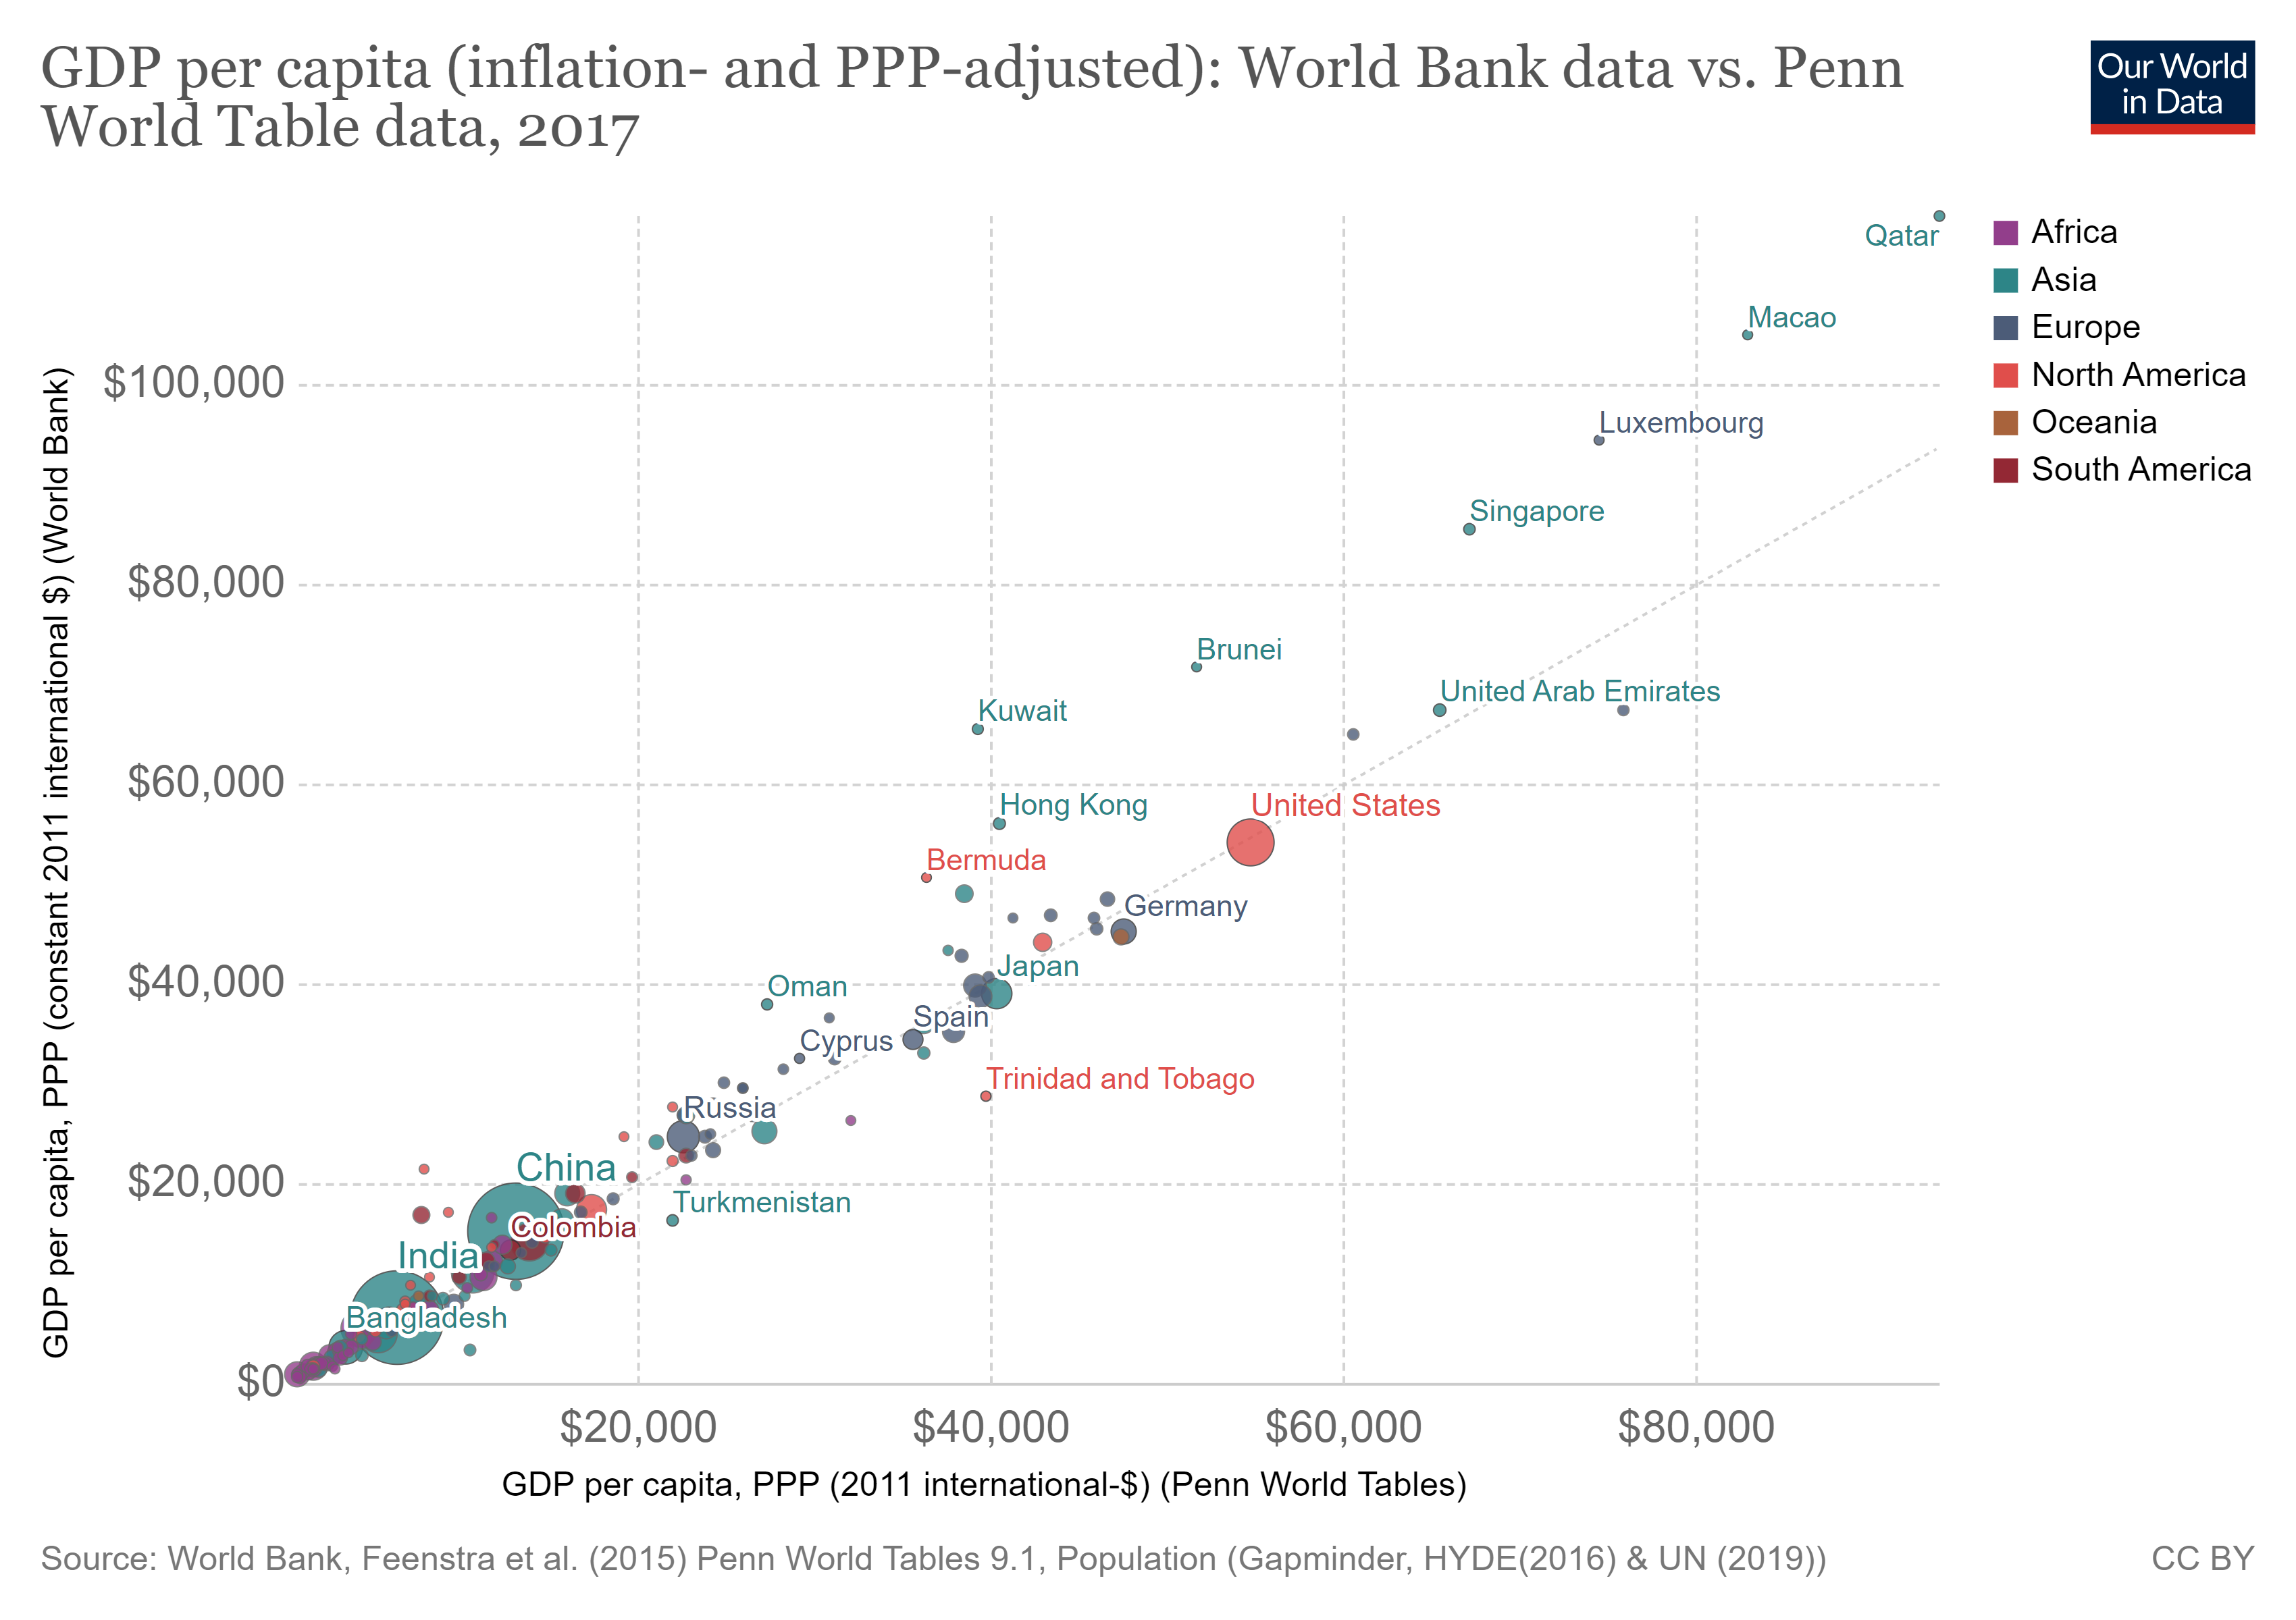
Initial
Concerns
WB vs PWT

Slide 12
Sink OFC and Conduit OFC
Tax haven countries
Total Acumulated Milenia of Schooling (TAMS)
Avg. Adult Schooling x Population 25+
Scientific Production Coefficient (SPC)
Documents / TAMS
Scientific Quality Coefficient (SQC)
Citations per document x SPC
Initial
Concerns
Feature
Engineering

Slide 13
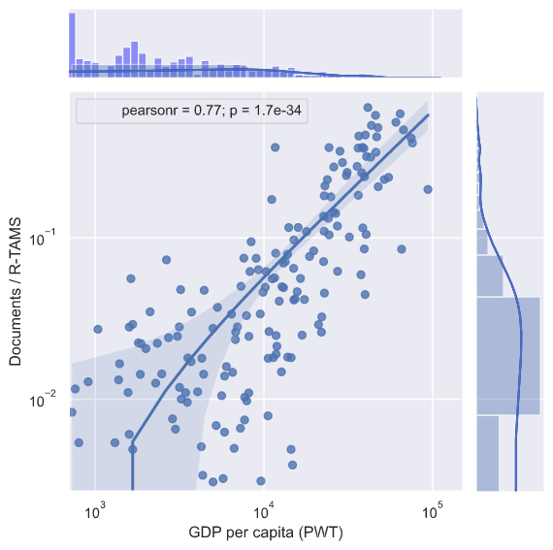
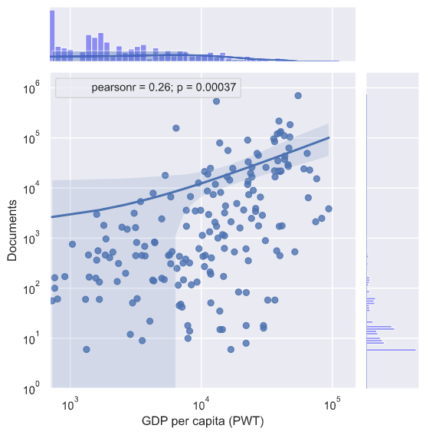
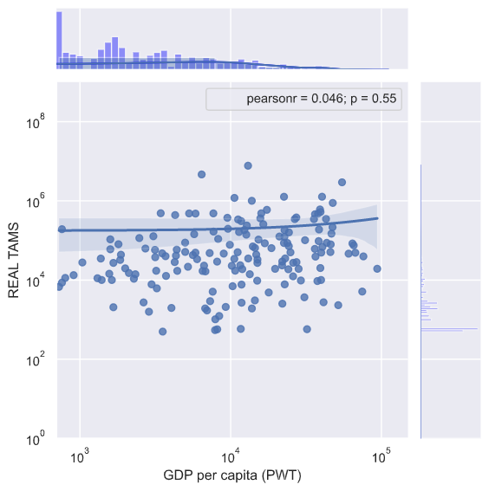
Documentos
TAMS
SPC
vs.
GDP per capita
R² = 0,59
R² = 0,07
R² = 0,002

Slide 14
Independent | 0
Sink OFC | 0
Conduit OFC | 0
Code | 0
Country | 0
Year | 0
Population | 0
Population 25 Years Before | 0
Population 25+ | 4701
Population 25+ / Population | 4701
Documents | 0
Citable documents | 0
Citations | 0
Self-citations | 0
Citations per Document | 0
H index | 0
Subject | 0
Avg. Adult Schooling | 15694
GDP per capita (World Bank) | 22729
GDP per capita (PWT) | 20643
Gov. Effectiveness | 17355
Charges for the use of intellectual property, payments (BoP, current US$) | 32251
Charges for the use of intellectual property, receipts (BoP, current US$) | 36479
Firms that spend on R&D (% of firms) | 103984
High-technology exports (current US$) | 66600
Industrial design applications, nonresident, by count | 65938
Industrial design applications, resident, by count | 65887
Labor force with advanced education (% of total working-age population with advanced education) | 67588
Patent applications, nonresidents | 45834
Patent applications, residents | 48089
Research and development expenditure (% of GDP) | 57364
Researchers in R&D (per million people) | 68395
Scientific and technical journal articles | 26578
Technicians in R&D (per million people) | 77768
Trademark applications, nonresident, by count | 70138
Trademark applications, resident, by count | 70116
Trademark applications, total | 39408
Patents / R-TAMS | 49498
Patents / M-TAMS | 49486
Initial
Concerns
Missing Data

Slide 15
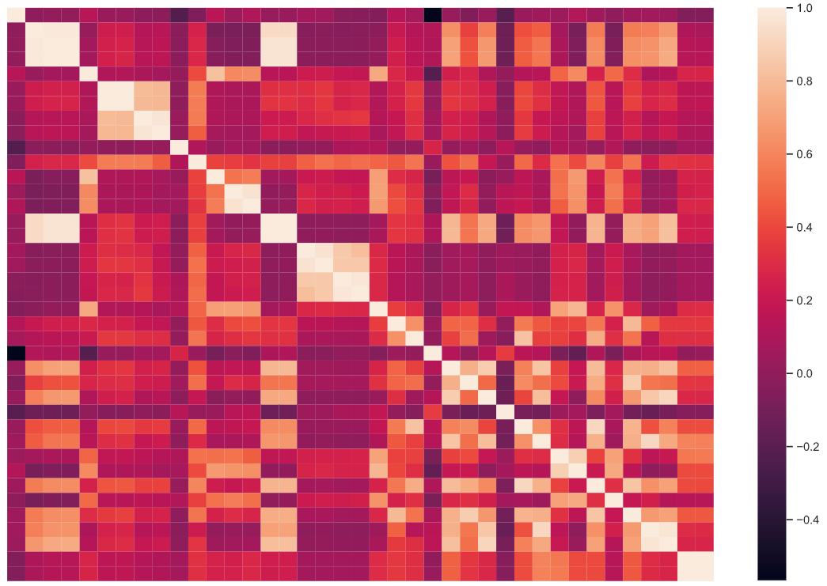
Population
Population 25 Years Before
Population 25+
Population 25+ / Population
Linear Regression → Fill NAs
Initial
Concerns
Population
Population 25 Years Before
Population 25+
Population 25+ / Population
Modeling Population 25+

Slide 16
Final Dataset
1996-2019
108864 rows, 45 columns

Slide 17
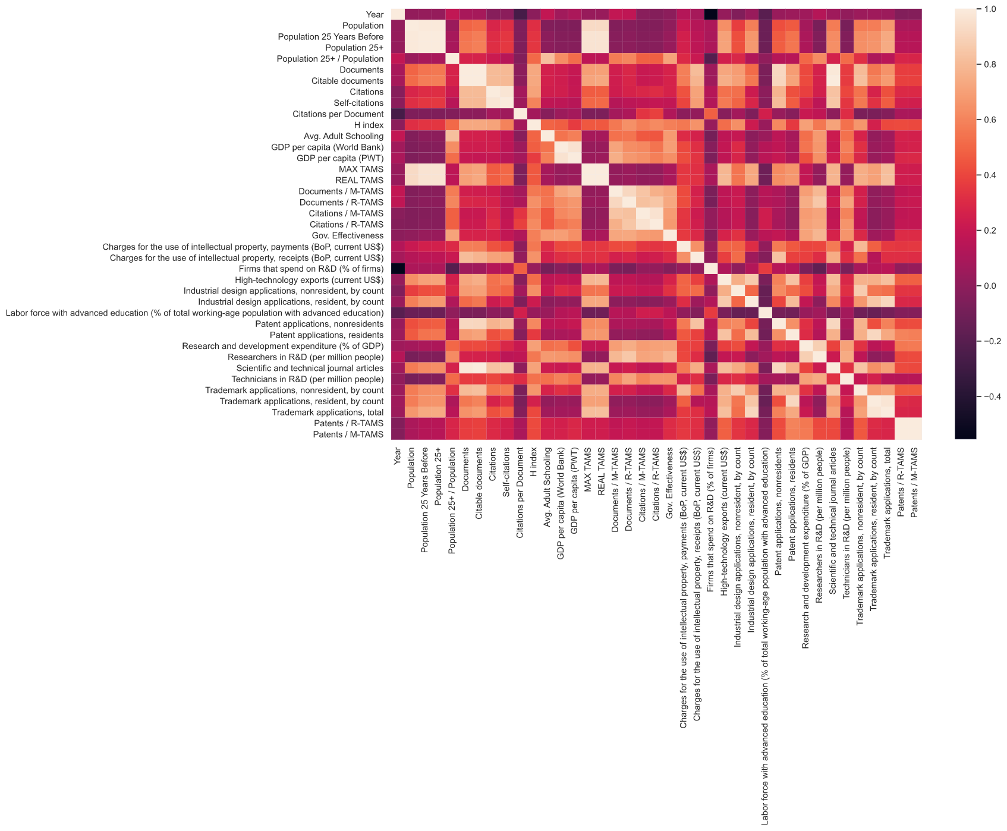
Initial model → Linear Regression
Normalization:
Standard Scaler on the whole dataset
Independent variable:
Documents / TAMS (SPC)
Gov. Effectiveness
Result (GDP per capita PWT):
R² = 0,52
Error (MAE) = US$ 6431,95

Slide 18
Linear Regression → Improvements
Addition of independente variables:
Payments for the use of intellectual property
Avg. Adult Schooling
Population 25+ / Population
Conduit OFC
Result (GDP per capita PWT):
R² = 0,62
Error (MAE) = US$ 5269,75

Slide 19
Linear Regression → Improvements
Exclude certain countries:
Sink OFC
Result (GDP per capita PWT):
R² = 0,86
Error (MAE) = US$ 3403,66

Slide 20
Linear Regression → Improvements
Polinomial Features:
degree = 2
Result (GDP per capita PWT):
R² = 0,87
Error (MAE) = US$ 3139,46

Slide 21
Linear Regression → Improvements
Exclude outliers:
-2.5 < GDP < 2,5
Result (GDP per capita PWT):
R² = 0,88
Error (MAE) = US$ 2988,67

Slide 22
Linear Regression → Improvements
Scientific production from 3 year before instead of query year
Result (GDP per capita PWT):
R² = 0,92
Error (MAE) = US$ 2917,48

Slide 23
Linear Regression → Improvements
Stratify training dataset:
GDP divided into categories
Result (GDP per capita PWT):
R² = 0,91
Error (MAE) = US$ 2808,54

Slide 24
Linear Regression → Improvements
Mean Scientific production from the last 3 years
Result (GDP per capita PWT):
R² = 0,91
Error (MAE) = US$ 2547,48

Slide 25
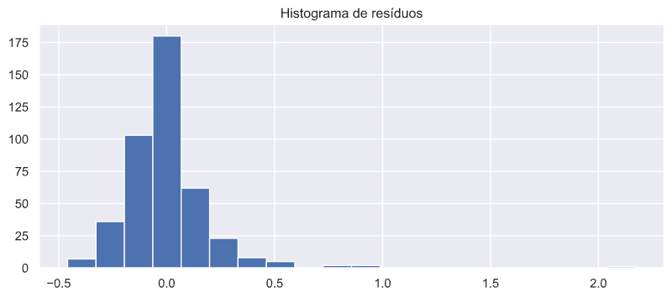
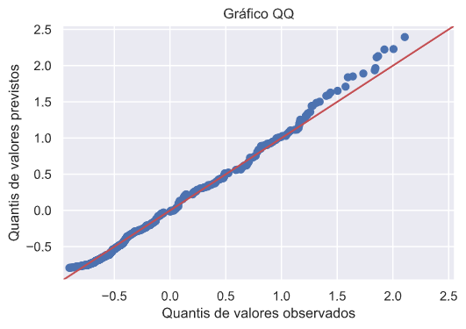
Linear Regression → Error Analyses

Slide 26
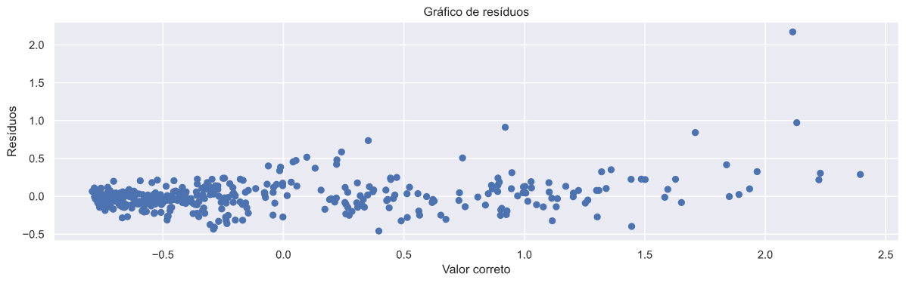
Linear Regression → Error Analyses

Slide 27
Linear Regression → Summary
We make more mistakes for rich countries (Std > 1.2)
High-error countries (absolute residue > 0,5):
'Belarus', 'Brunei Darussalam', 'Italy', 'Kazakhstan', 'Kuwait’, 'Norway', 'Saint Kitts and Nevis', 'Saudi Arabia', 'Singapore','Trinidad and Tobago’
Error countries (absolute residue > 0,25):
'Armenia', 'Australia', 'Austria', 'Azerbaijan', 'Canada', 'Chile','Croatia','Dominican Republic', 'Estonia', 'Fiji', 'Finland', 'Georgia','Greece', 'Hungary', 'Iraq','Ireland', 'Israel','Jamaica', 'Netherlands','New Zealand', 'Portugal', 'Republic of Moldova', 'Russian Federation','Saint Lucia','Slovenia', 'South Africa', 'Switzerland','Tunisia', 'Turkey','Ukraine','United Kingdom', 'United States of America', 'Venezuela','Angola', 'Haiti'

Slide 28
Other models→ Summary
SVM | Decision Tree | Random Forest | GBM
0,91 | 0,90 | 0,91 | 0,96
US$ 2550,92 | US$ 2637,46 | US$ 2693,63 | US$ 2144,78

Slide 29
Future experiments
Run GridSearchCV for all models; test ensemble; implement PCA
Investigate similarities between error countries
Fill-in NAs for other independent variables (ex: Avg. Schooling)
Add GDP data (category) from 3 years ago
Implement polinomial features befores standard normalization
Notes:
Séries temporais! Dados devem ser tratados de foram diferente.

Slide 30
obriAgado

